Slide 1
Center for Modeling Social Systems (CMSS)
- NORCE Norwegian Research Centre AS

Slide 2
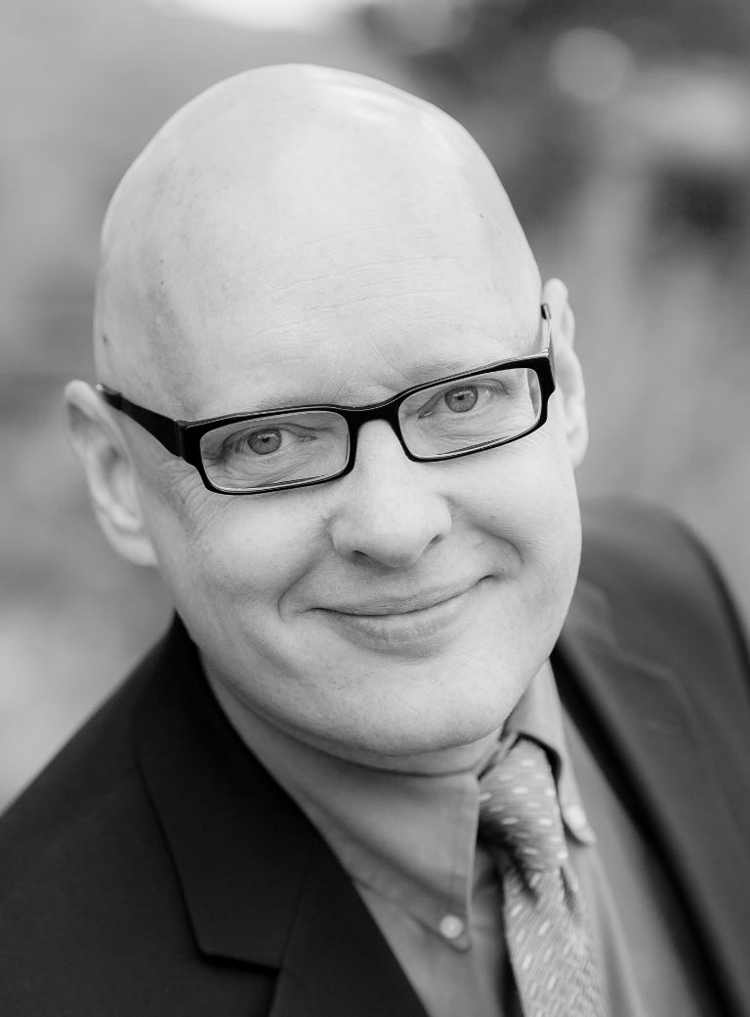
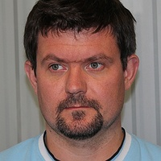
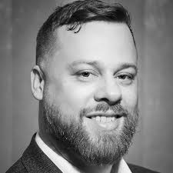
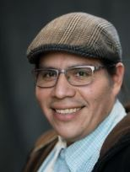
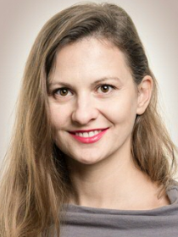
CMSS Core Team
F. LeRon Shults
Research Professor
Roger Normann
Chief Scientist
Justin Lane
Researcher II
Ivan Puga-Gonzalez
Researcher II
Patrycja Antosz
Researcher II

Slide 3
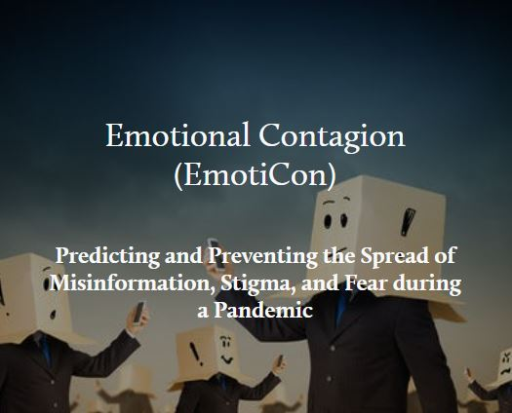
Preview

Slide 4
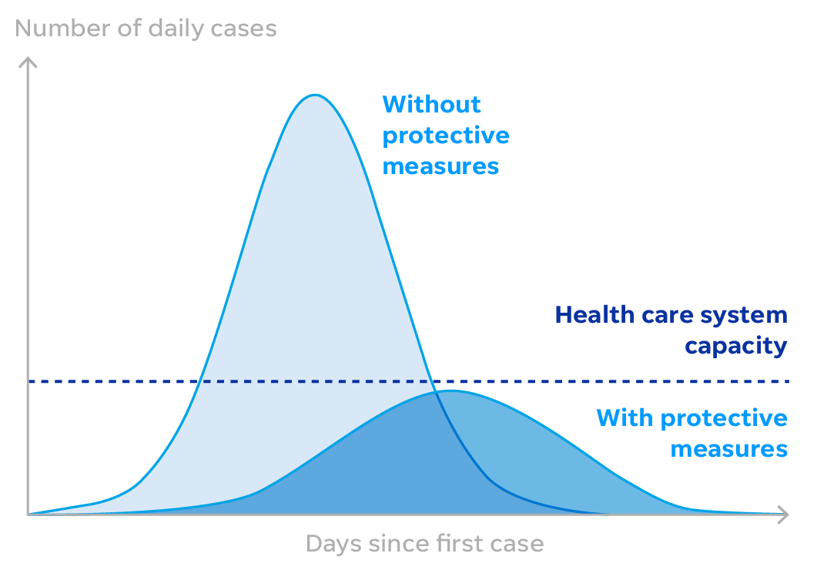
The EmotiCon Project
"Flattening the curve" of emotional contagion so that the spread of anxiety, stigma, and misinformation do not pass a threshold and threaten social cohesion in Norway.

Slide 5
What is Social Simulation?
Complex Societal Challenges
Testing Hypotheses and Policy Interventions
Social Sciences
Natural Sciences
Computer Sciences
Humanities Disciplines
Artificial Society (Digital Twin)

Slide 6
What is Social Simulation?
Multi-agent artificial intelligence modeling
Artificial societies
From statistical pictures to simulated movies
Generative social science: what causes the emergence of complex societal challenges?

Slide 7




The EmotiCon Project
Phase 1 – Social Media Analysis
Phase 3 –
Agent-Based Model
Phase 2 – Panel Survey Analysis

Slide 8
The COVID-19 dugnad and voting
Those who are more likely not to follow the national and local COVID-19 policy measures tend to be highly committed to their Norwegian identity and are more likely to vote.
Willingness to make sacrifices for Norway (identity fusion with the country) has significantly weakened since the beginning of the pandemic.

Slide 9
COVID-19 conspiracy theories
Notes:
In Norway it is less the case that people actively entertain misbeliefs, and more that case that they are hesitant and not able to confidently denounce misbeliefs.
Smililar case for conspiracy theories.

Slide 10
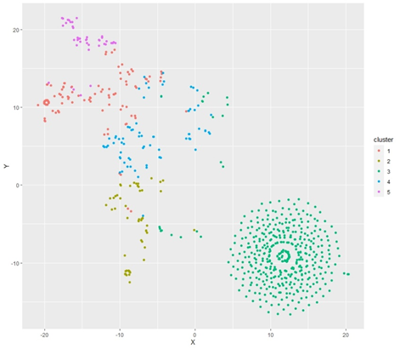
The "Blob" represents the largest cluster of Norwegians, who are skeptical of COVID-19 conspiracy theories.
However, 40% of respondents did not deny at least one conspiracy theory listed in the survey.

Slide 11
Generally, positive changes over time
It is possible that publicly funded researchers manipulate knowledge about COVID-19
October 2020 April 2021
58%
17%
17%
7%
1%
63%
17%
13%
6%
2%
Notes:
Observed changes in beliefs over time, if significant, are in general optimistic (with the exception of the UV lights myth).

Slide 12
However, not all changes are optimistic
It is possible that publicly funded researchers manipulate knowledge about COVID-19
October 2020 April 2021
58%
17%
17%
7%
1%
63%
17%
13%
6%
2%
22% changed their mind in the right direction
61% maintained previous attitude
17% got more confident in this conspiracy
Notes:
Anyone can swing - The direction of change in beliefs does NOT depend on socio-demographic characteristics!
It’s not to say that the change is random. There are other factors that influence it (my best guess is that the secret is in social networks ;) ), we need more analyses to know what they are.

Slide 13
Education is the arch enemy of misinformation and conspiracies
Education is our best weapon. Higher education does not make one immune, but it does render one a lot less prone to being infected with popular misbeliefs.
Older people (60+) with lower levels of education are less likely to believe conspiracy theories compared to their younger peers. Higher age has a similar effect to an additional level of education on resilience to misbeliefs.
Notes:
Importantly, not a single socio-demographic groups is immune to misinformation and conspiracies.
Education and age matter when you FIRST form an opinion. Later changes in that opinion are not predicted by socio-demography.
Studies on the change of opinions and e.g. the role of social networks very difficult with conventional methods. Luckily, we have ABM that allows us to test hypotheses about possible mechanisms responsible for observed patterns in data.

Slide 14
Who changes and why?
Research Question:
Under what conditions – and by which mechanisms – do misinformation, stigma, and anxiety spread among Norwegians in the wake of a pandemic (or other crisis)?

Slide 15
Simulating Emotional Contagion
Spread of Anxiety, Misinformation and Stigma
Testing Hypotheses and Policy Interventions
Social Sciences
Natural Sciences
Computer Sciences
Humanities Disciplines
Artificial Society (Digital Twin)

Slide 16
CMSS mission
We work with transdisciplinary teams to co-create conceptual and computational models for analyzing and predicting societal change.

Slide 17
Q&A
F. LeRon Shults
lesh@norceresearch.no
norceresearch.no
@NORCEresearch

